Slide 1
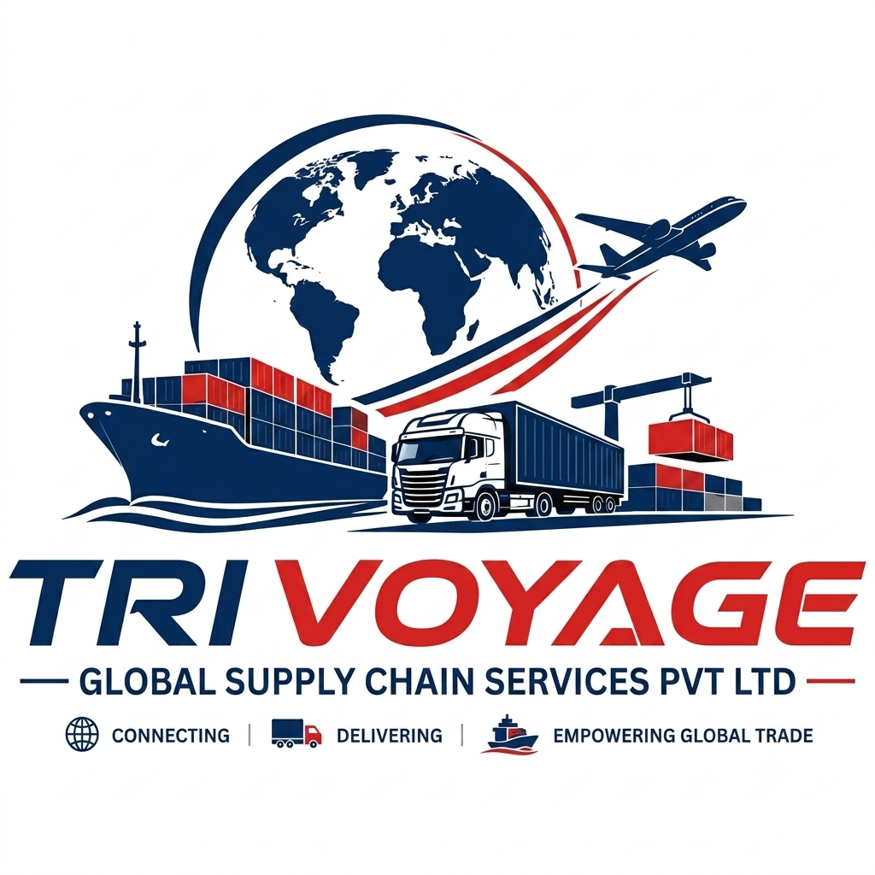
COMPANY
PROFILE
Logistics • Import • Export
Global Supply Chain Services
TRIVOYAGE
GLOBAL SUPPLY CHAIN SERVICES PVT LTD
Connecting • Delivering • Empowering Global Trade
Professional Company Profile

Slide 2
Company Overview
A dependable partner for end-to-end international trade and logistics
Who We Are
01
Single-window coordination
TRIVOYAGE GLOBAL SUPPLY CHAIN SERVICES PVT LTD is positioned as a logistics, import and export service partner focused on making cargo
movement simple, coordinated and transparent.
We support businesses with practical solutions across transportation,
shipment coordination, documentation, customs support and supply-chain
execution.
Our approach combines responsive communication, operational discipline
and a customer-first mindset.
02
Import & export support
03
Multi-modal logistics
04
Customer-focused execution
TRIVOYAGE GLOBAL SUPPLY CHAIN SERVICES PVT LTD
02

Slide 3
Vision, Mission & Values
The principles that shape how we serve customers and partners
Our Vision
Our Mission
To be a trusted and agile global supply-chain partner that
connects businesses to markets through dependable
logistics and trade solutions.
To deliver coordinated logistics, import and export support
with clear communication, operational reliability and
service excellence.
Reliability
Transparency
Commitment to timelines, documentation and service
follow-through.
Clear updates, commercial clarity and proactive communication.
Agility
Partnership
Practical solutions that adapt to changing shipment requirements.
Long-term relationships built around customer success.
TRIVOYAGE GLOBAL SUPPLY CHAIN SERVICES PVT LTD
03

Slide 4
Our Core Services
Integrated logistics and trade support under one service framework
01
Freight Forwarding
02
Import Services
03
Export Services
Sea, air and road shipment
coordination from origin to
destination.
Shipment handling, documentation
and delivery coordination
for inbound cargo.
Export shipment planning,
documentation and carrier coordination.
04
Customs Support
05
Transportation
06
Supply Chain Support
Coordination of customs-related
documentation and clearance
activities.
Pre-carriage, inland movement and
last-mile delivery coordination.
Shipment visibility, vendor coordination and end-to-end execution.
TRIVOYAGE GLOBAL SUPPLY CHAIN SERVICES PVT LTD
04

Slide 5
Import Logistics Services
Supporting smooth movement of inbound cargo into the destination market
01
Shipment Planning
Review cargo, origin, destination, mode and required delivery timeline.
02
Supplier / Origin
Coordination
Coordinate pickup details, shipping instructions and document readiness.
03
Freight & Documentation
Coordinate booking, transport documents and shipment milestones.
04
Customs Coordination
Support the documentation flow required for customs and statutory processes.
05
Delivery Management
Coordinate inland transportation and final delivery to the consignee.
IMPORT SUPPORT
TRIVOYAGE GLOBAL SUPPLY CHAIN SERVICES PVT LTD
05

Slide 6
Export Logistics Services
Helping exporters prepare, move and deliver cargo with confidence
Export Execution
• Export shipment planning and mode selection
• Pickup and origin coordination
• Booking and carrier coordination
• Commercial and shipping documentation support
• Customs clearance coordination
• Container / cargo movement monitoring
We coordinate the operational steps that help
export shipments move efficiently from supplier
premises to the international gateway
and onward to the buyer.
Service scope can be aligned to the shipment type,
Incoterm, destination, cargo profile and customer
requirements.
Key shipment considerations
Incoterms
Mode
Cargo
Destination
TRIVOYAGE GLOBAL SUPPLY CHAIN SERVICES PVT LTD
06

Slide 7
Freight & Transportation Solutions
Selecting the right mode based on cost, urgency, cargo and destination
SEA FREIGHT
AIR FREIGHT
ROAD TRANSPORT
FCL / LCL
Express / General
FTL / LTL
Cost-efficient solution for international
l cargo
and larger volumes.
Time-sensitive shipments requiring
faster I
international transit.
Flexible inland transportation
for domestic
and cross-border movement.
Mode selection is based on shipment requirements, availability, service level and commercial considerations.
TRIVOYAGE GLOBAL SUPPLY CHAIN SERVICES PVT LTD
07

Slide 8
Documentation & Customs Coordination
Reducing avoidable delays through organized shipment documentation
Commercial Invoice
Packing List
Commercial details and transaction value
Package, weight, dimensions and cargo details
Transport Documents
Customs Documentation
Bill of Lading / Air Waybill and related documents
Coordination of documents required for clearance
Certificate Support
Shipment Records
Coordination for applicable certificates and declarations
Organized milestone and document tracking
Note: Specific documents and regulatory requirements vary by commodity, origin, destination and applicable regulations.
TRIVOYAGE GLOBAL SUPPLY CHAIN SERVICES PVT LTD
08

Slide 9
End-to-End Shipment Process
A simple workflow designed for visibility and controlled execution
1
2
3
4
5
6
Inquiry
Quotation
Booking
Documentation
Movement
Delivery
Understand cargo,
route and
service requirement
Align scope, mode
and commercial
proposal
Confirm carrier
/ transport and
shipment plan
Prepare and
coordinate
required documents
Monitor pickup,
transit and key
milestones
Coordinate destination
handling and final
delivery
Customer Communication
Proactive shipment updates, clear escalation paths and practical coordination at each key milestone.
TRIVOYAGE GLOBAL SUPPLY CHAIN SERVICES PVT LTD
09

Slide 10
Industries We Can Support
Flexible logistics solutions for diverse cargo and business requirements
Manufacturing
Engineering
Automotive
Raw materials, components
and finished goods
Project cargo, equipment
and industrial supplies
Parts, components
and related cargo
Consumer Goods
Retail & E-commerce
Agri & General Trade
Packaged products and
commercial shipments
Inbound and outbound
distribution support
Commodity and general
cargo movements
TRIVOYAGE GLOBAL SUPPLY CHAIN SERVICES PVT LTD
10

Slide 11
Why Partner With Trivoyage?
Built around service discipline, communication and practical logistics execution
1
Customer-first approach
2
Single-point coordination
Solutions are structured around the shipment
requirement and business objective.
One coordinated service flow across transport,
documentation and delivery.
3
Responsive communication
4
Operational flexibility
Timely updates and clear communication
throughout the shipment lifecycle.
Support across different shipment sizes, modes
and routing requirements.
5
Trade-focused mindset
6
Long-term partnership
Understanding of the practical needs of
importers, exporters and trading businesses.
Focused on dependable service and relationships
that grow with our customers.
TRIVOYAGE GLOBAL SUPPLY CHAIN SERVICES PVT LTD
11

Slide 12
Global Trade Connectivity
Connecting origin markets, international gateways and destination businesses
ORIGIN
GATEWAY
DESTINATION
International sourcing & export
Freight & documentation
Import & final delivery
Our Positioning
A coordinated logistics partner for businesses that need reliable movement of goods across borders and supply-chain touchpoints.
TRIVOYAGE GLOBAL SUPPLY CHAIN SERVICES PVT LTD
12

Slide 13
LET'S MOVE YOUR BUSINESS
FORWARD
TRIVOYAGE GLOBAL SUPPLY CHAIN SERVICES PVT LTD
Logistics • Import • Export • Supply Chain Services
Address: [KALASH, FIRST FLOOR-3, NR DIAMOND 27,
CHANDKHEDA, AHMEDABAD – 382424
GUJARAT INDIA]
Email: [admin@trivoyageglobal.com]
Phone: [+91 9825026513,
+91 9924758973]
Website: www.trivoyageglobal.in
Connecting • Delivering • Empowering Global Trade

